Slide 1
Data Science
UNIT-V Forecasting Techniques
Dr. N. Subhash Chandra
Professor CSE

Slide 2
UNIT-1: Contents
UNIT V – Prescriptive Analysis
Forecasting Techniques: Time series data, Techniques, and accuracy, Moving average method, Single, double, triple exponential smoothing, Regression model for forecasting, Auto-Regression models, ARIMA Process.
Graph Analytics: Path analysis, Connectivity analysis, Community analysis, Centrality analysis, Social-Network Graphs, Communities and Clusters, Betweenness, The Girvan-Newman Algorithm.

Slide 3
What is Forecasting?
Forecasting is the process of making predictions about future events based on historical data and analysis.
It's widely used in various fields such as finance, economics, supply chain management, and meteorology. There are several techniques for forecasting, broadly
Forecasting techniques categorized into
Qualitative Tools: These are based on a judgment we make based on experience and analysis of future trends. Due to the dependency of this tool on individual judgment, the forecast is affected by human biases.
Quantitative Tools: These tools forecast data by analyzing past data. Further, it relies on statistical methods to make future predictions. These methods can be:
  Time Series Analysis
  Casual Methods

Slide 4
TIME-SERIES DATA AND COMPONENTS OF TIME-SERIES DATA
Time-series data is a data on a response variable, Yt, such as demand for a spare parts of a capital equipment or a product or a service or market share of a brand observed at different time points t.
Whenever we have a forecasting problem, we will be using a time-series data. The variable Yt is a random variable.
The data points or measurements are usually collected at regular intervals and are arranged in chronological order.
If the time-series data contains observations of just a single variable (such as demand of a product at time t), then it is termed as univariate time series.
If the data consists of more than one variable, for example, demand for a product at time t, price at time t, amount of money spent by the company on promotion at time t, competitors price at time t, etc. then it is called multivariate time-series data.

Slide 5


COMPONENTS OF TIME-SERIES DATA
Trend Component (Tt): Trend is the consistent long-term upward or downward movement of the data over a period of time.
Seasonal Component (St): Seasonal component (measured using seasonality index) is the repetitive upward or downward movement (or fluctuations) from the trend that occurs within a calendar year such as seasons, quarters, months, days of the week,
Cyclical Component (Ct): Cyclical component is fluctuation around the trend line that happens due to macro-economic changes such as recession, unemployment, etc.
Irregular Component (It): Irregular component is the white noise or random uncorrelated changes that follow a normal distribution with mean value of 0 and constant variance.
The time-series data can be modelled as an addition of the above components or product of the above components. The additive time-series model is given by

Slide 6
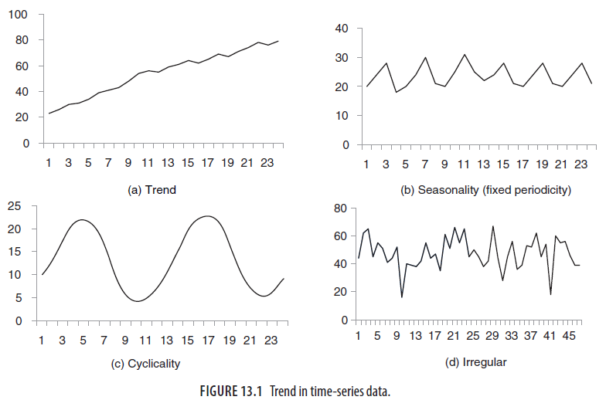
Trends in Timeseries data

Slide 7
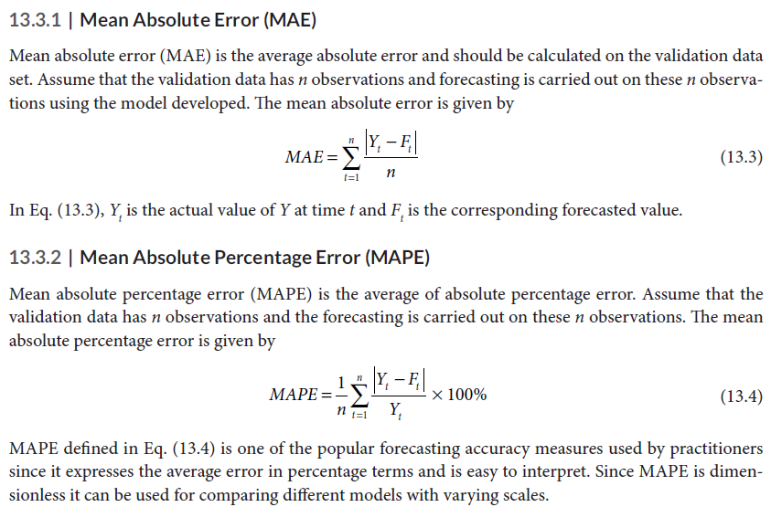
FORECASTING TECHNIQUES AND FORECASTING ACCURACY

Slide 8
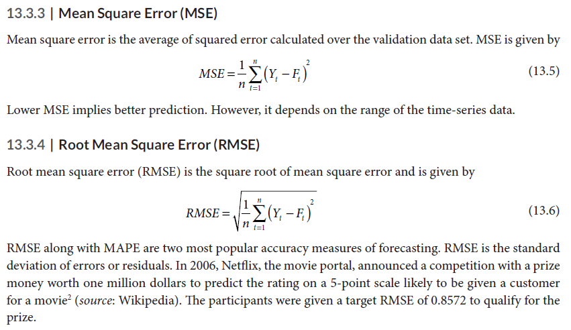
FORECASTING TECHNIQUES AND FORECASTING ACCURACY

Slide 9
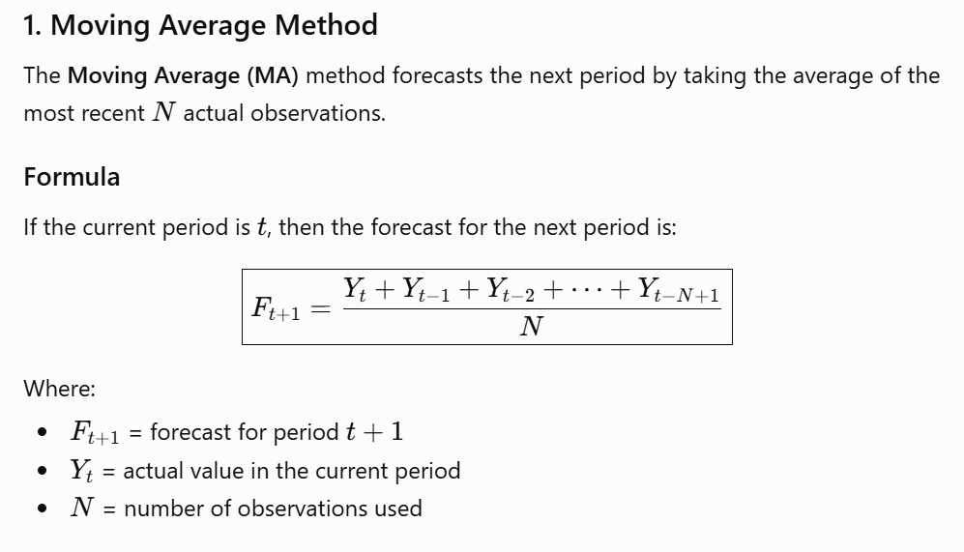
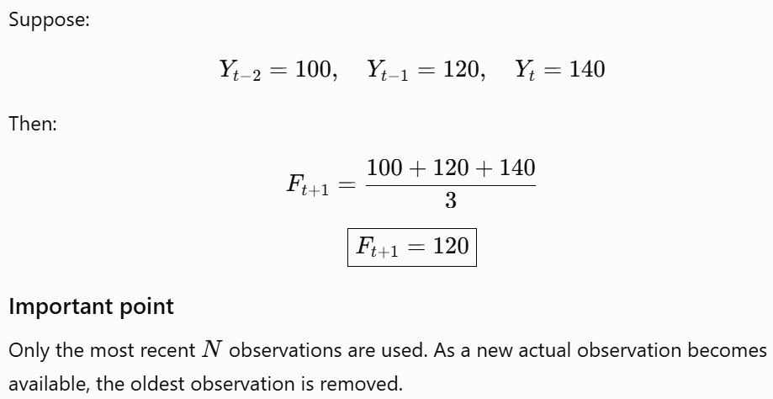
MOVING AVERAGE METHOD

Slide 10
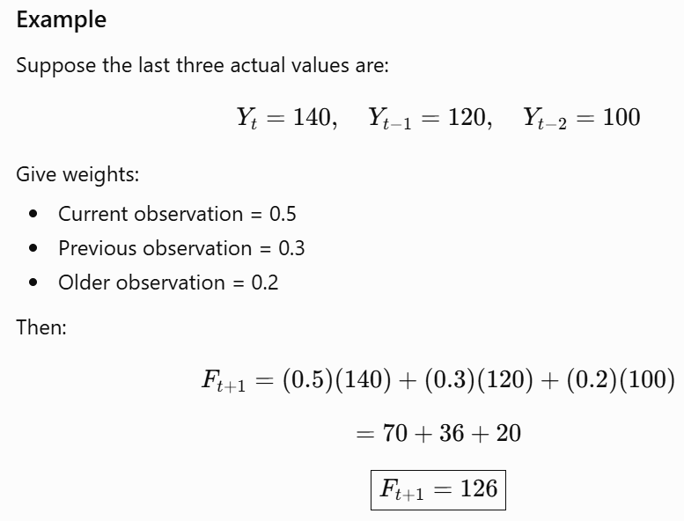
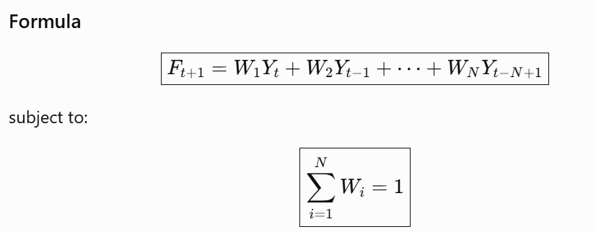
WEIGHTED MOVING AVERAGE METHOD
In the Weighted Moving Average, different weights are assigned to past observations. Usually, more weight is given to recent observations.

Slide 11
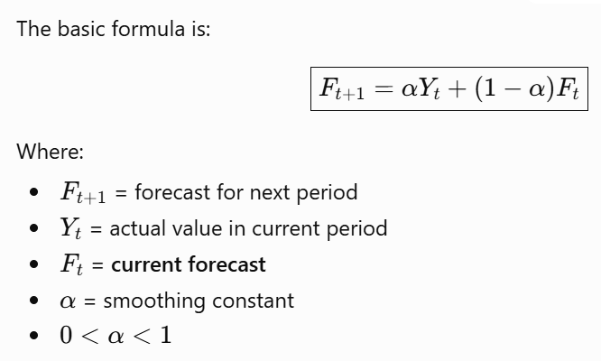
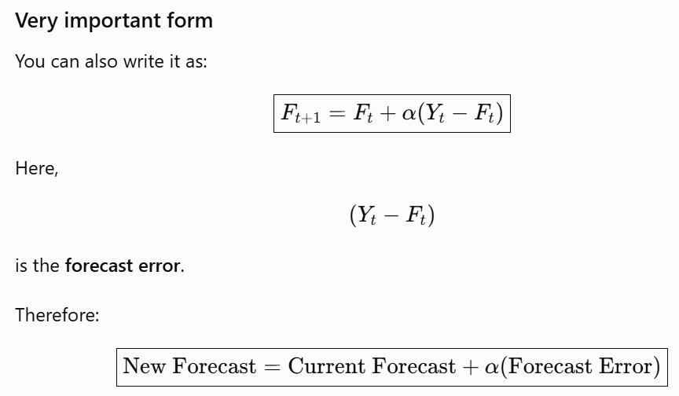
SINGLE EXPONENTIAL SMOOTHING (ES)
Single Exponential Smoothing is appropriate when the time series has a fairly stable level without significant trend or seasonality. Dinesh Kumar uses the smoothing constant $α$, where $0<α<1$.

Slide 12
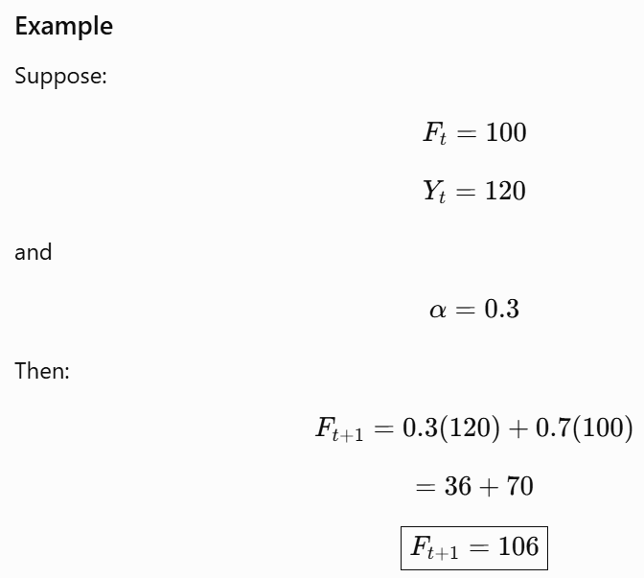
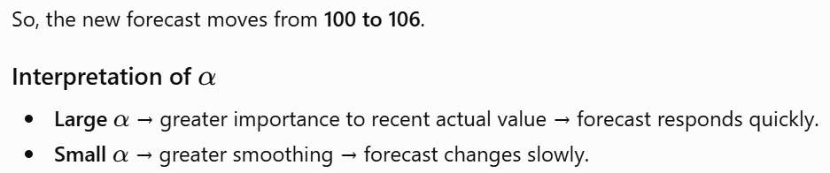
SINGLE EXPONENTIAL SMOOTHING (ES)

Slide 13
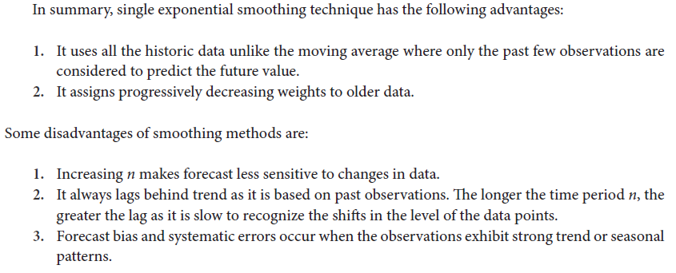
SINGLE EXPONENTIAL SMOOTHING (ES)

Slide 14
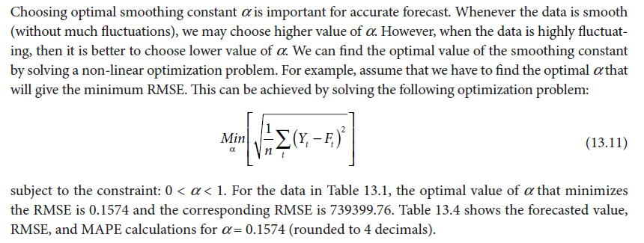
Optimal Smoothing Constant in a Single Exponential Smoothing (SES)

Slide 15
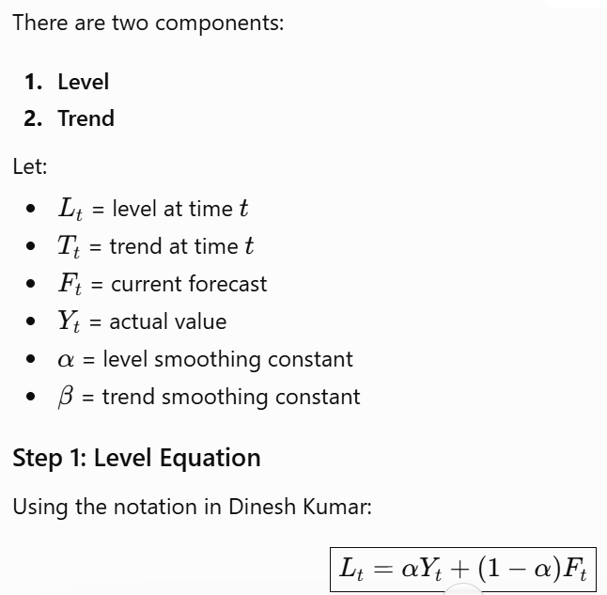
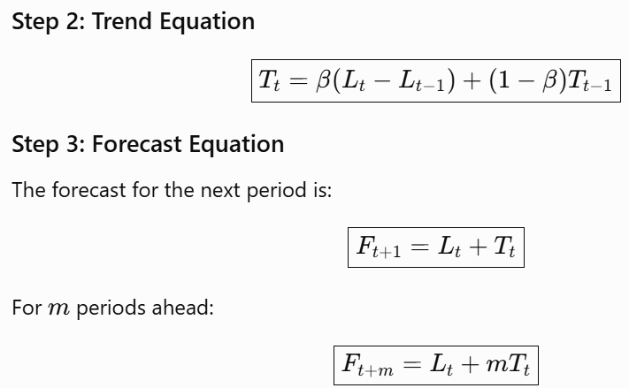
DOUBLE EXPONENTIAL SMOOTHING – HOLT’S METHOD
Single exponential smoothing has a limitation: it cannot adequately handle a trend. Holt's Double Exponential Smoothing introduces a second equation to capture the trend.

Slide 16
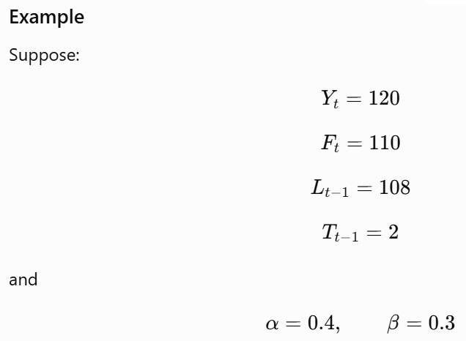
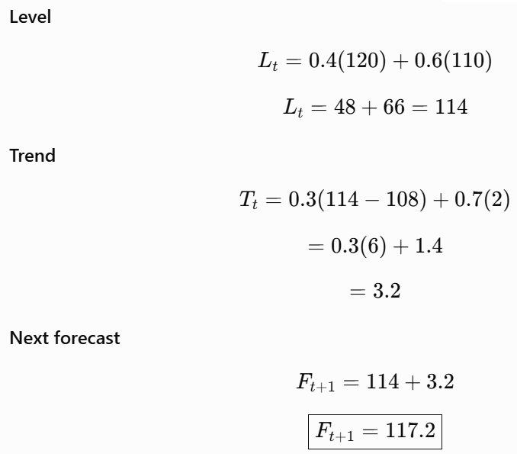
DOUBLE EXPONENTIAL SMOOTHING – HOLT’S METHOD

Slide 17
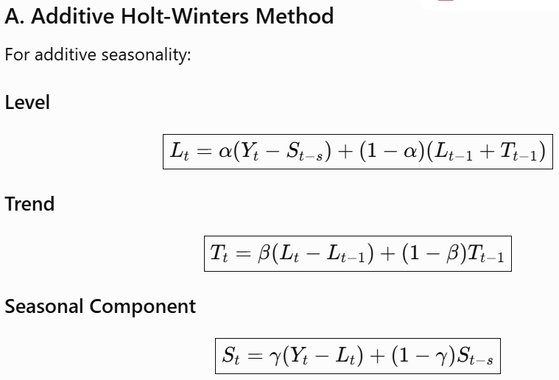
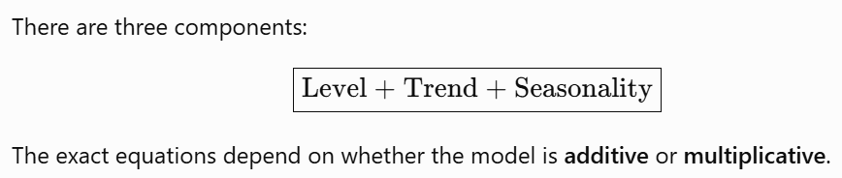
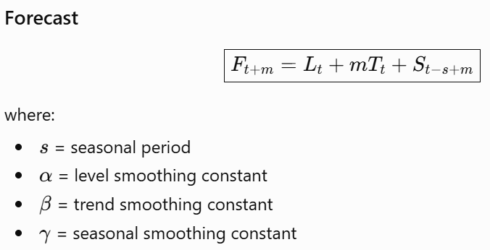
TRIPLE EXPONENTIAL SMOOTHING (HOLT-WINTER MODEL)
Triple Exponential Smoothing, also called the Holt-Winters Model, is used when the time series contains:
Level
Trend
Seasonality

Slide 18
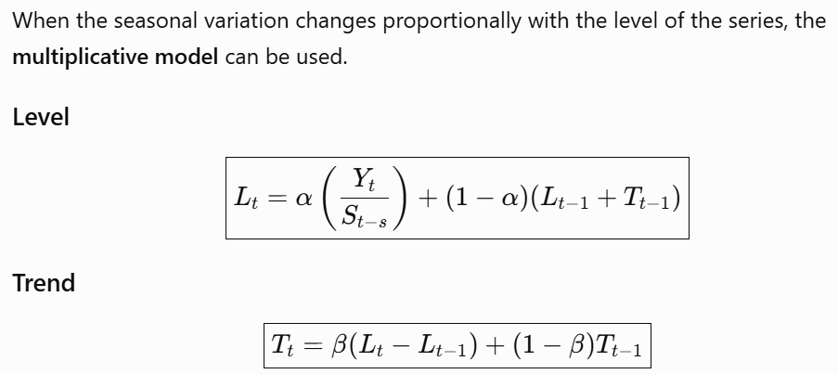
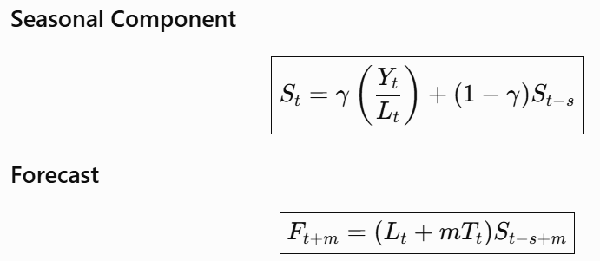
TRIPLE EXPONENTIAL SMOOTHING (Multiplicative Holt-Winters Method)

Slide 19
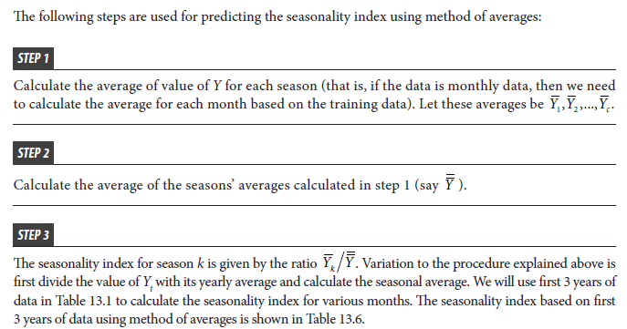
Predicting Seasonality Index Using Method of Averages

Slide 20
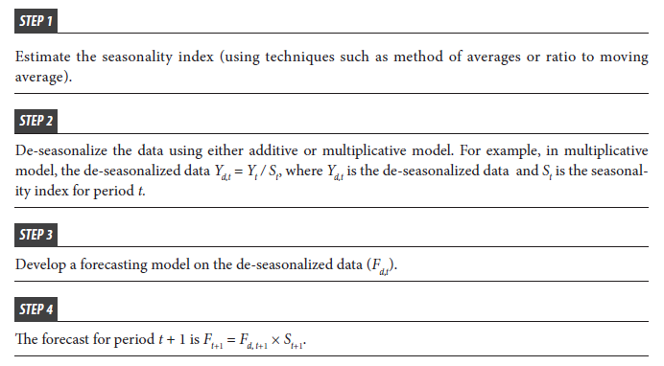
Forecasting Time-Series Data with Seasonal Variation

Slide 21
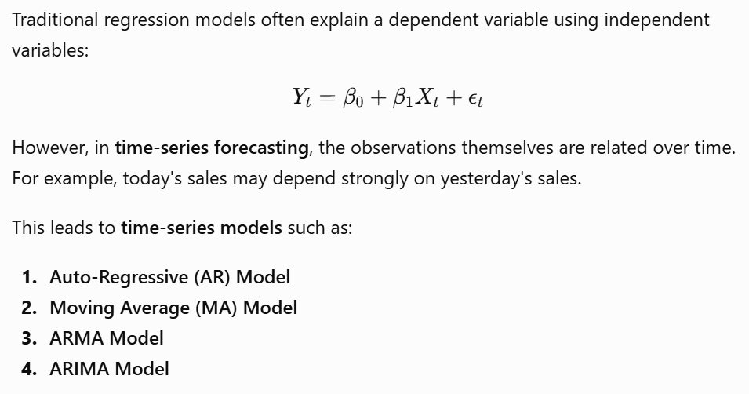
REGRESSION MODEL FOR FORECASTING
Regression Models for Time-Series Forecasting:
In business analytics, forecasting means predicting future values of a variable using its historical observations.

Slide 22
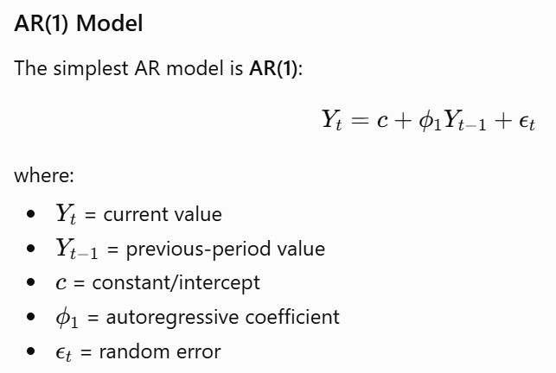
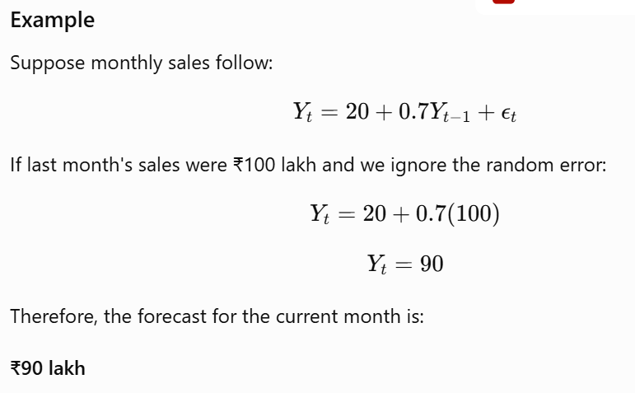
AUTO-REGRESSIVE (AR) MODELS
Auto-Regressive means that the current value of a time series is explained by its own previous values.

Slide 23
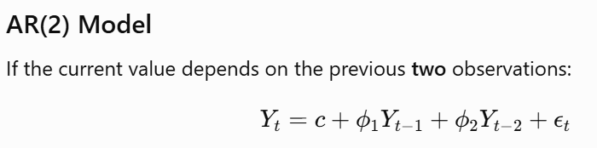
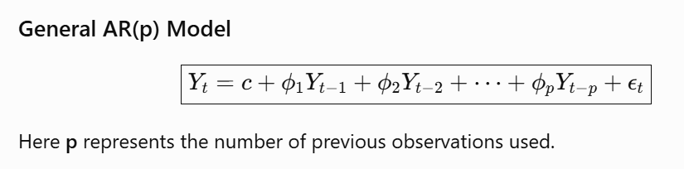
Stationarity Assumption
Stationarity: A key assumption of AR models is that the time series is stationary. This means that its properties (mean, variance, autocorrelation) do not change over time.
Stationarity ensures that the relationships between lags and the series are stable and meaningful over time.
If the series is non-stationary (e.g., has a trend), differencing may be applied to make it stationary before fitting an AR model.

Slide 24
Limitations of AR Models
Linearity: AR models assume linear relationships between the current and lagged values.
Stationarity: They require the series to be stationary, which may not be the case in many real-world time series.
Overfitting: Including too many lags can result in overfitting, where the model captures noise rather than the underlying pattern.
Applications of AR Models
Economics and Finance: Predicting stock prices, interest rates, and inflation rates.
Weather Forecasting: Estimating future weather conditions based on historical data.
Sales Forecasting: Predicting future sales based on past trends.
Extensions of AR Models
ARMA (Autoregressive Moving Average) Models: Combine AR with a moving average (MA) component.
ARIMA (Autoregressive Integrated Moving Average) Models: Extend ARMA to handle non-stationary series using differencing.

Slide 25
Moving Average (MA) Models
Moving Average (MA) models are a type of time series model where the current value of the series is expressed as a linear combination of past error terms (also known as residuals or shocks).
In contrast to Autoregressive (AR) models, where the past values of the series itself are used, MA models use past forecast errors to explain the current observation.
Time series data involves observations taken over regular time intervals (e.g., monthly sales data, daily temperatures).
Moving Regression vs. Traditional Regression:
Traditional Regression: Assumes relationships between variables are static over time.
Moving Regression: Assumes relationships can change as time progresses, fitting models to rolling windows of data.
Better for time series forecasting in dynamic environments.

Slide 26
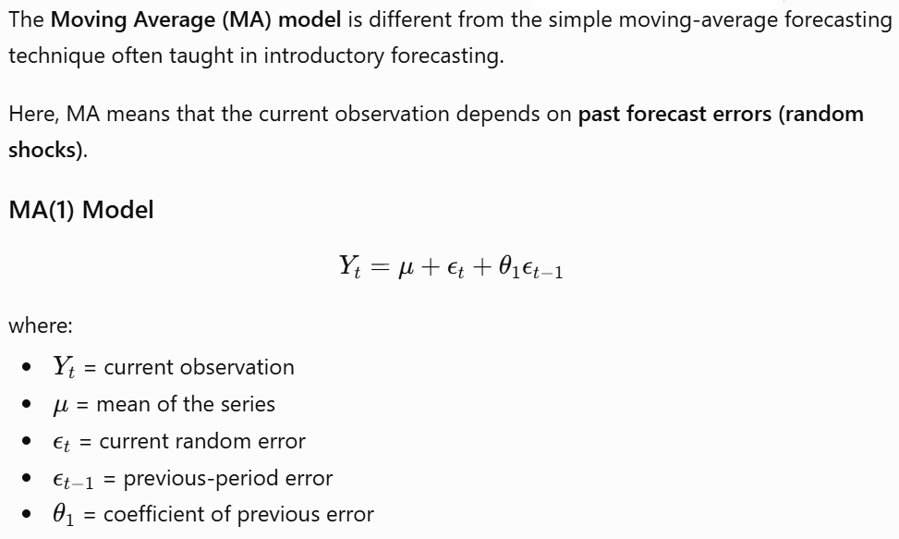
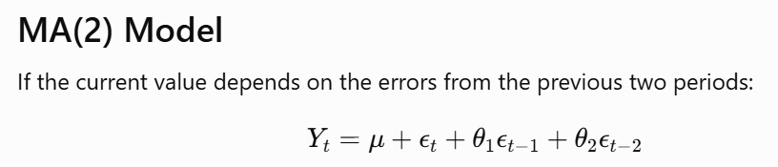

Slide 27
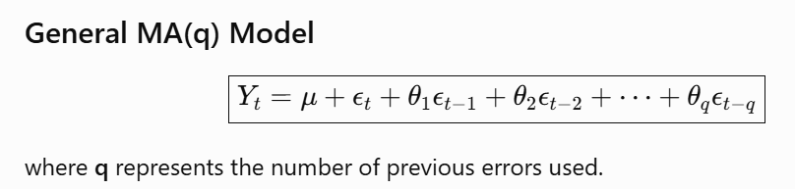
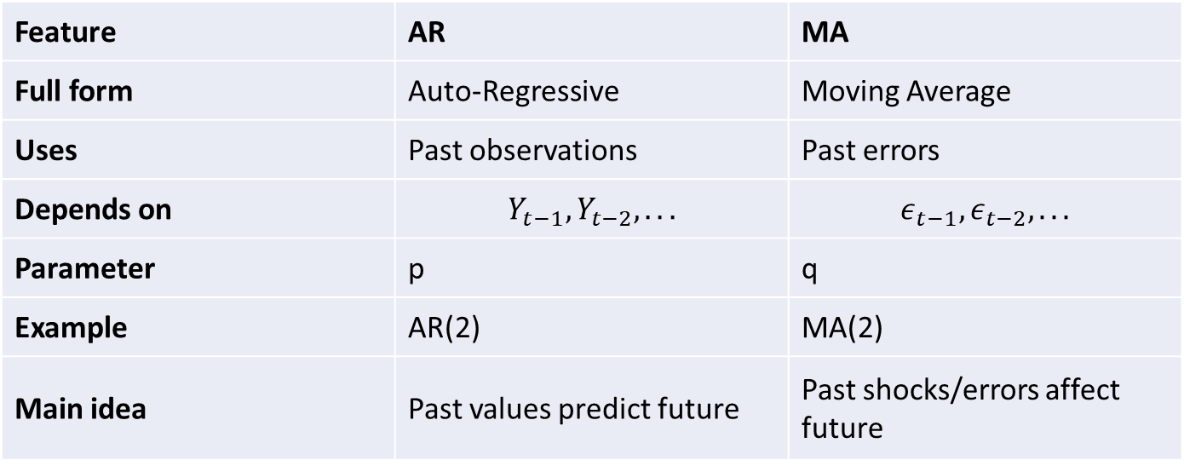
Feature | AR | MA
Full form | Auto-Regressive | Moving Average
Uses | Past observations | Past errors
Depends on | $$Y_{t−1},Y_{t−2},...$$ | $$ε_{t−1},ε_{t−2},...$$
Parameter | p | q
Example | AR(2) | MA(2)
Main idea | Past values predict future | Past shocks/errors affect future

Slide 28
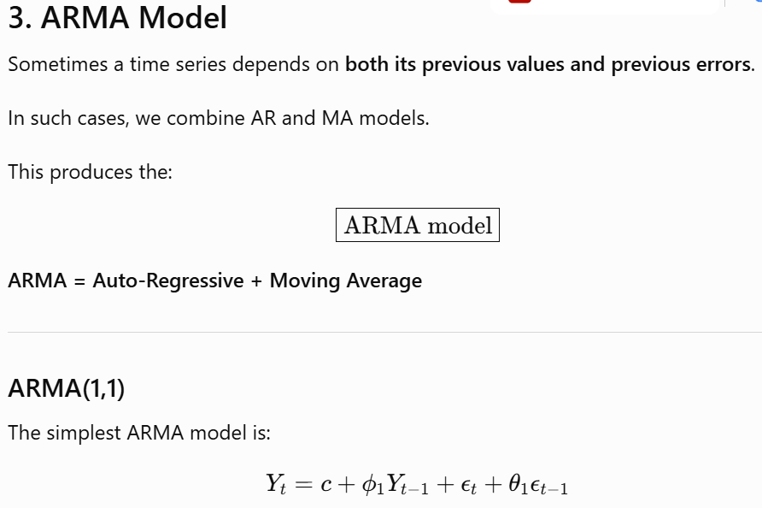
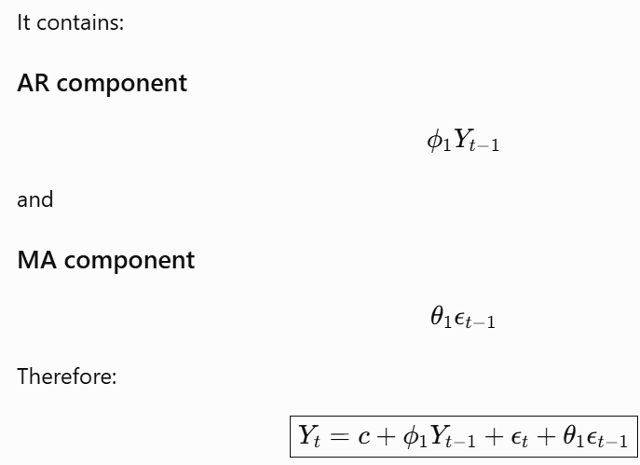

Slide 29
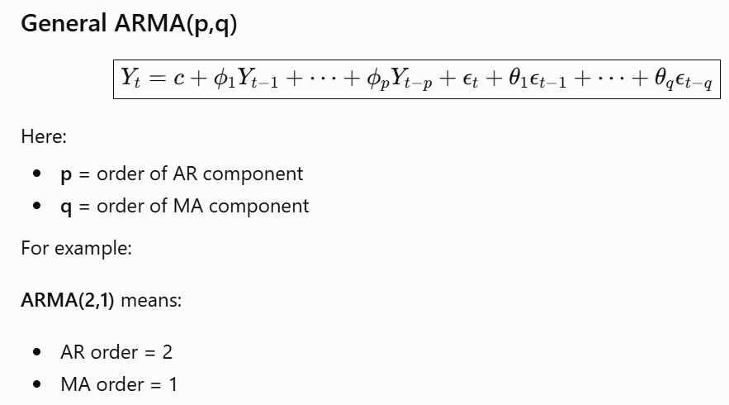

Slide 30
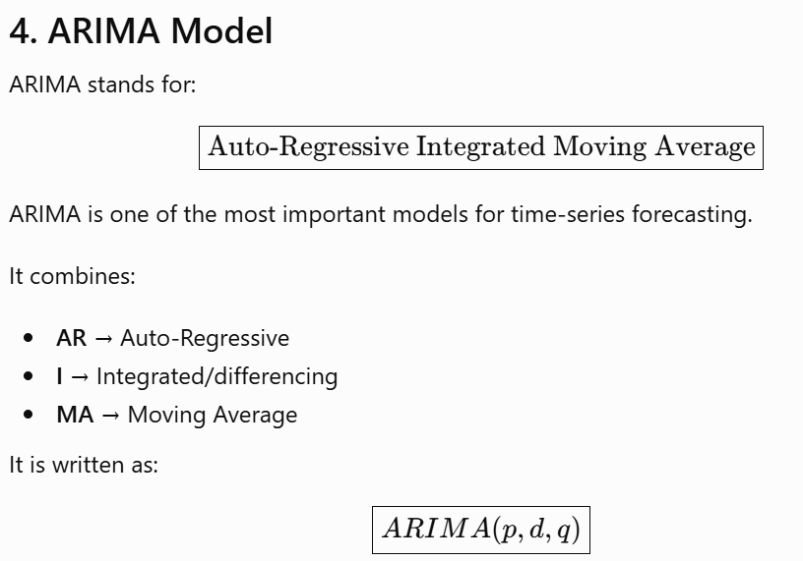
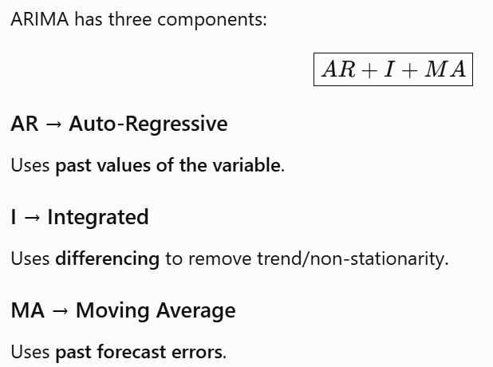
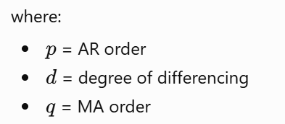

Slide 31
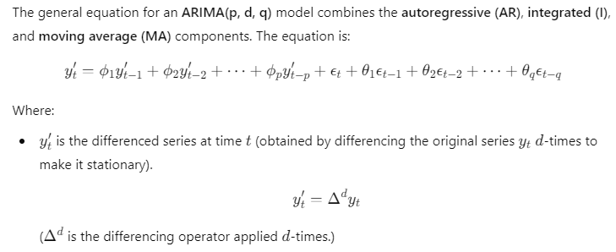
ARIMA Models

Slide 32
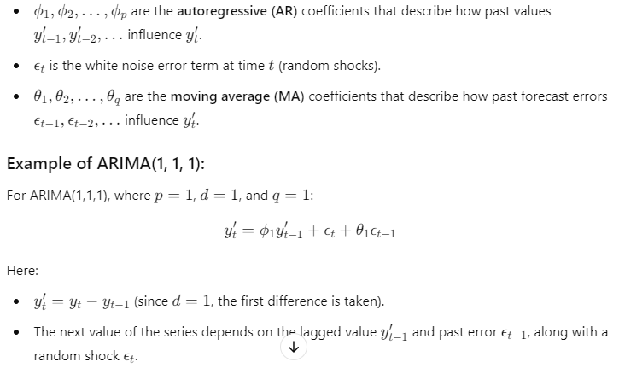
ARIMA Models

Slide 33
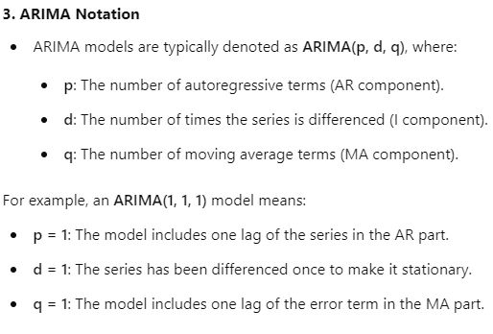
ARIMA Models

Slide 34
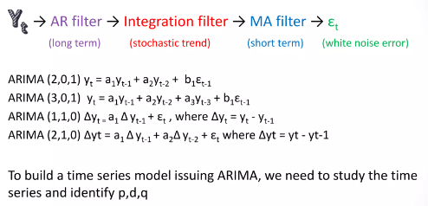
ARIMA Models

Slide 35
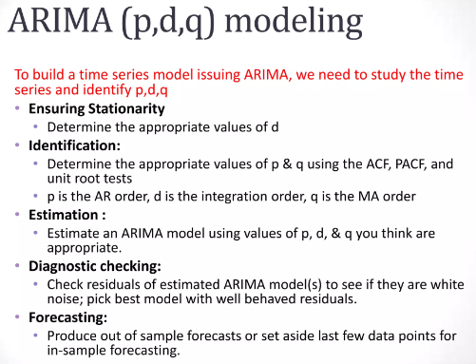
ARIMA Modelling

Slide 36
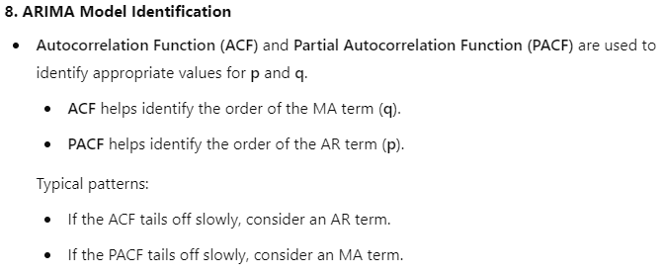
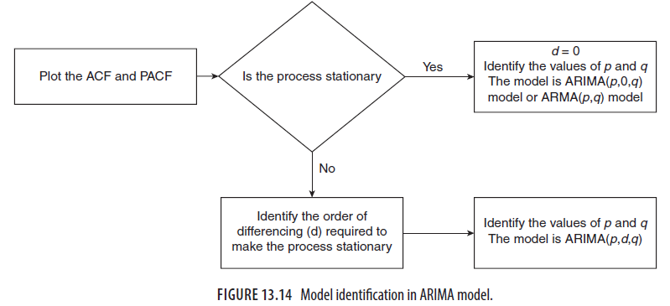

Slide 37
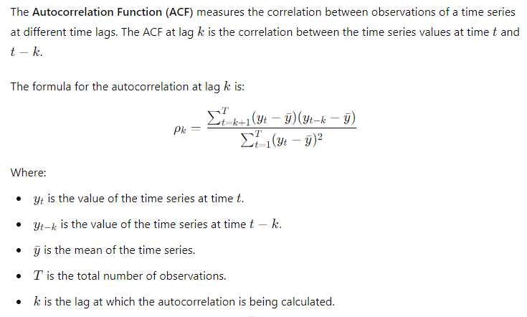
Autocorrelation Function(ACF)

Slide 38
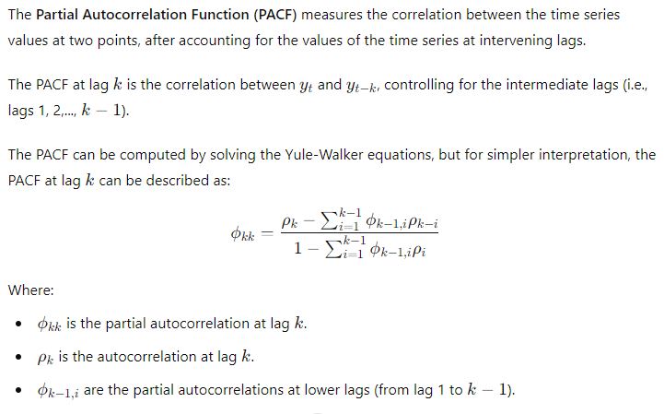
Partial Autocorrelation Function(PACF)

Slide 39
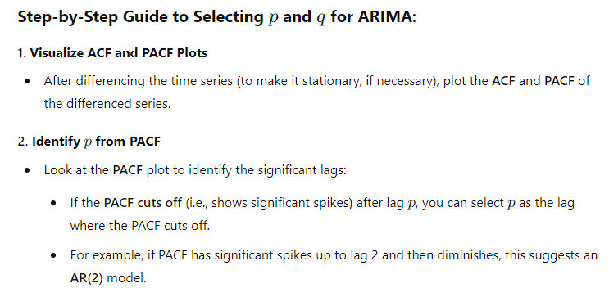
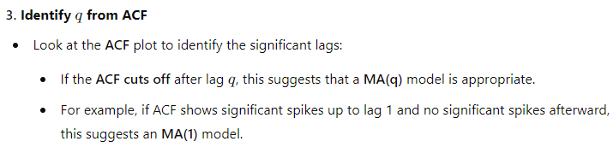

Slide 40


p=1,2,3
q=1

Slide 41


Example for differencing

Slide 42
Seasonal ARIMA (SARIMA)
When time series data exhibits seasonality, the basic ARIMA model is extended to SARIMA (Seasonal ARIMA).
SARIMA adds seasonal components to the AR, MA, and differencing parts.
SARIMA notation is ARIMA(p, d, q)(P, D, Q)m, where:
  p,d,q Non seasonal order
  P, D, Q are the seasonal orders for AR, differencing, and MA.
  m is the number of periods per season (e.g., m = 12 for monthly data with annual seasonality).

Slide 43
Limitations of ARIMA Models:
Linear Assumption: ARIMA models assume that the relationships between past values and future values are linear.
Stationarity Requirement: The model requires stationary data, which may not always be the case.
Short-Term Forecasting: ARIMA models are typically more effective for short-term forecasts, as long-term forecasts may suffer from increasing uncertainty.
Applications of ARIMA Models:
Economics and Finance: ARIMA is used to predict stock prices, interest rates, GDP growth, and inflation.
Sales Forecasting: Retailers use ARIMA to forecast future sales based on historical data.
Environmental Science: ARIMA models are used to predict temperature changes, rainfall, and pollution levels.

Slide 44


Slide 45



